Slide 1
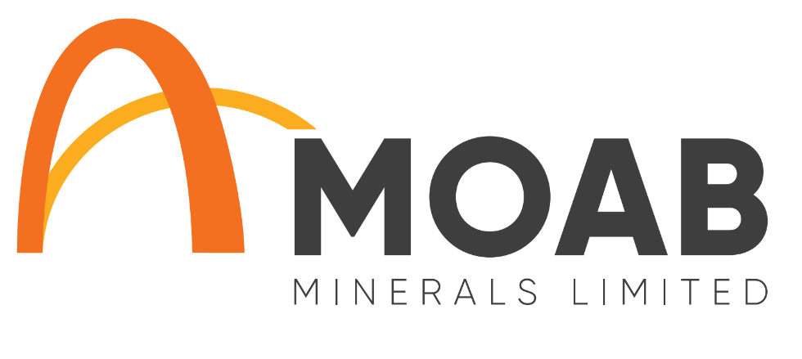
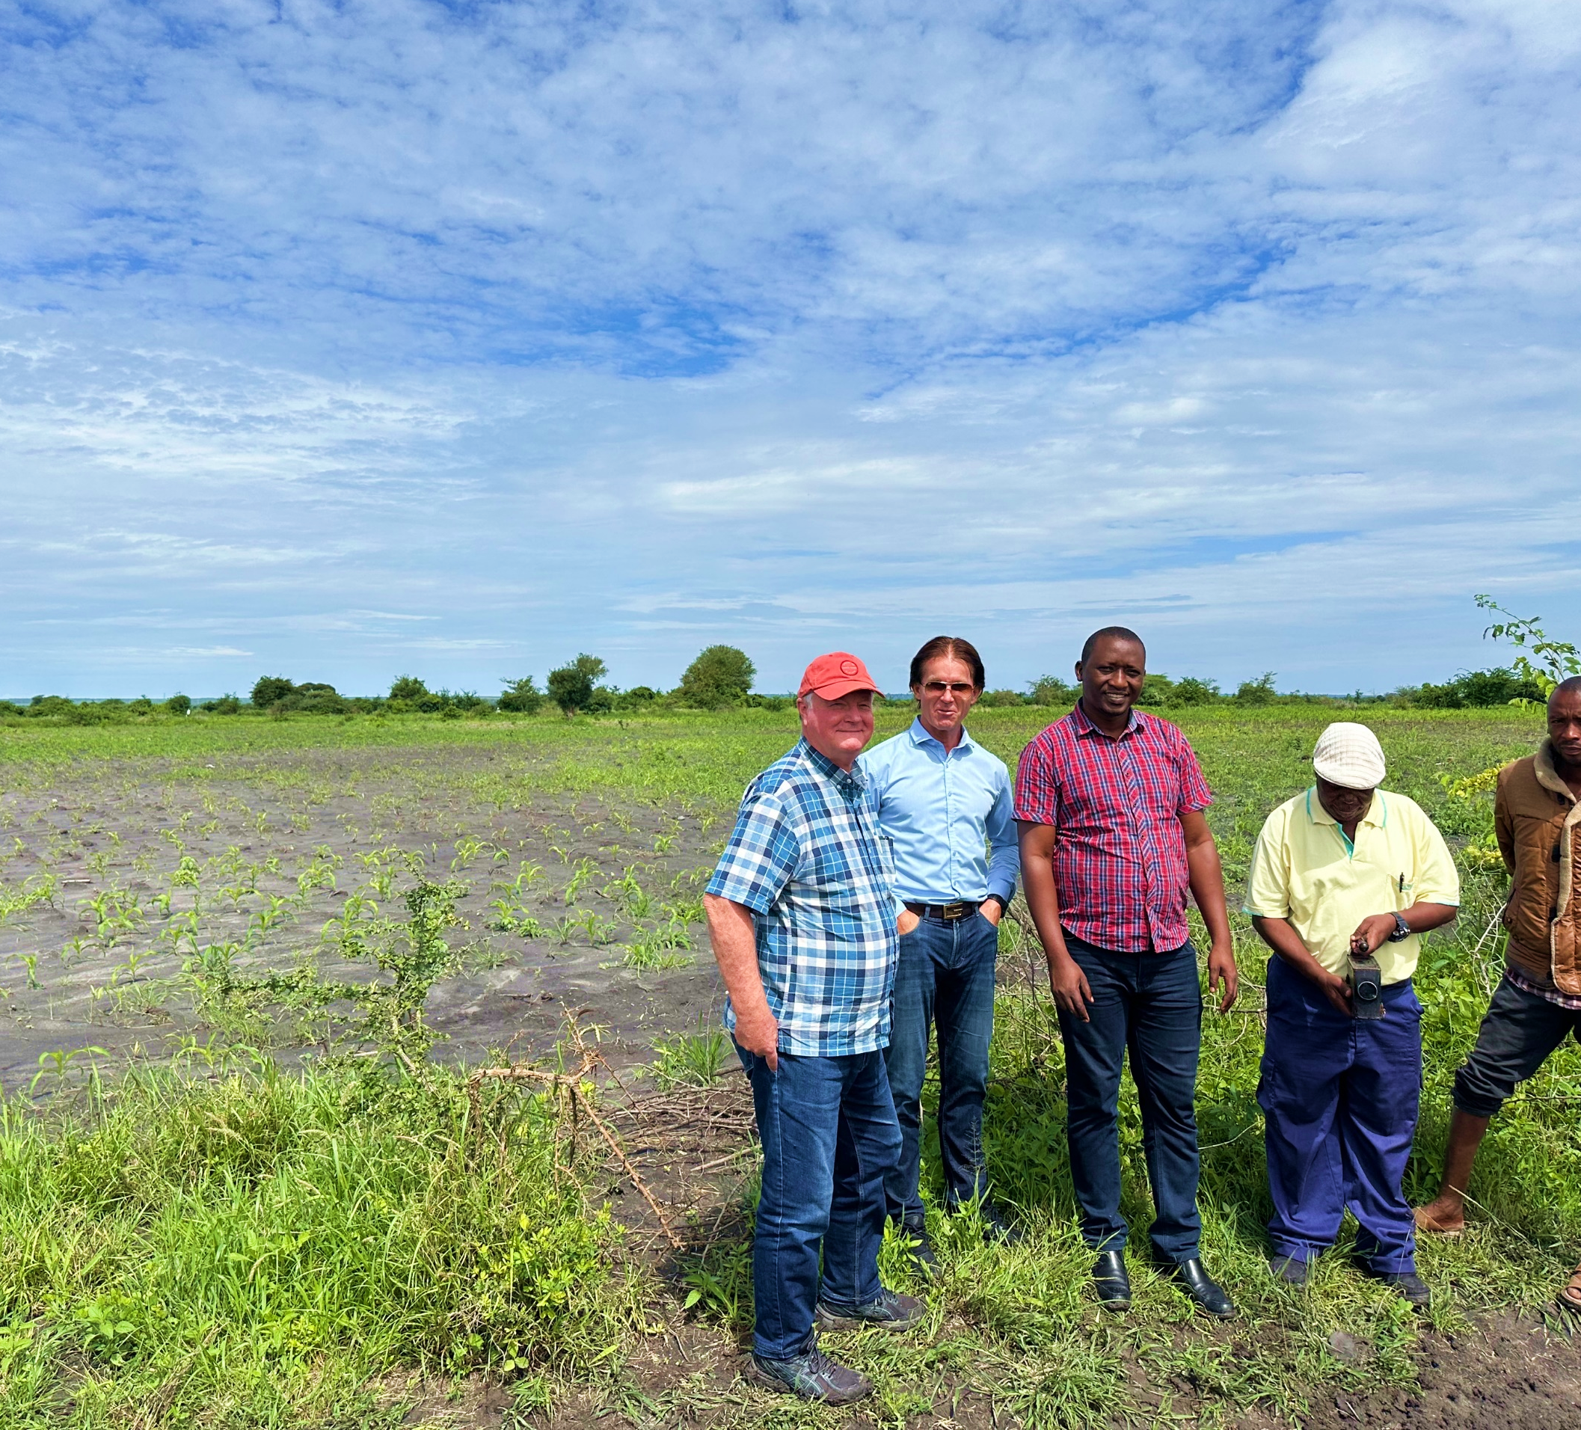

ASX:MOM
MOAB Minerals
USA & Tanzania
INVESTOR PRESENTATION
DECEMBER 2024

Slide 2

Disclaimer & Forward Looking Statements
This presentation is not a prospectus nor an offer of securities for subscription or sale in any jurisdiction nor a securities recommendation. The information in this presentation is an overview and does not contain all information necessary for investment decisions. In making investment decisions, investors should rely on their own examination of Moab Minerals Limited (Company) and consult with their own legal, tax, business and/or financial advisers. The information contained in this presentation has been prepared in good faith by the Company. However, no representation or warranty, express or implied, is made as to the completeness or adequacy of any statements, estimates, opinions or other information contained in this presentation. To the maximum extent permitted by law, the Company, its directors, officers, employees and agents disclaim liability for any loss or damage which may be suffered by any person through the use of, or reliance on, anything contained in or omitted from this presentation. Certain information in this presentation refers to the intentions of the Company, but these are not intended to be forecasts, forward looking statements, or statements about future matters for the purposes of the Corporations Act 2001 (Cth) or any other applicable law.
The occurrence of events in the future are subject to risks, uncertainties and other factors that may affect the Company’s actual results, performance or achievements to differ from those referred to in this presentation to occur as contemplated. The presentation contains only a synopsis of more detailed information available in relation to the matters described in this document and accordingly no reliance may be placed for any purpose whatsoever on the sufficiency or completeness of such information and to do so could potentially expose you to a significant risk of losing any of the property invested by you or incurring by you of additional liability. Recipients of this presentation should conduct their own investigation, evaluation and analysis of the business, data and property described in this presentation. In particular, any estimates or projections or opinions contained herein necessarily involve significant elements of subjective judgment, analysis and assumptions and you should satisfy yourself in relation to such matters.
Competent Person Statement
The information in this presentation as it relates to exploration results and geology was compiled by Mr Geoff Balfe who is a Member of the Australasian Institute of Mining and Metallurgy and a Certified Professional. Mr Balfe is a consultant to Moab Minerals Ltd. Mr Balfe has sufficient experience which is relevant to the style of mineralisation and type of Exploration Results, Mineral Resources and Ore Reserves'. Mr Balfe consents to the inclusion in the report of the matters based on the information in the form and context in which it appears.
2

Slide 3



Investment Highlights
A Multi-Jurisdictional Asset Portfolio (Tanzania & USA)
Tanzania assets provide significant potential upside
Manyoni Project & Octavo Projects (adjacent to Rosatom’s world class Nyota Uranium Deposit)
Two stage drilling program at Manyoni has commenced – results anticipated from Nov/Dec 2024
REX Uranium Project
Next prospective drilling program permit pending (Colorado, USA)
Moab seeking a JV partner given focus on Manyoni
Uranium prices close to 15-year highs
Continued geopolitical uncertainty and demand for decarbonised power
Uranium prices recently trending up (currently US$77/lb)
Low market capitalisation compared to peers
Providing significant leverage for shareholders
3

Slide 4

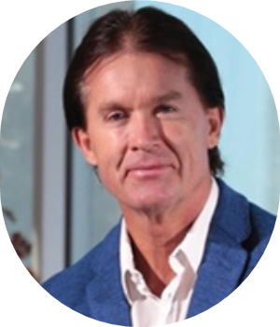
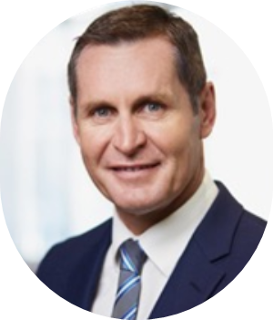
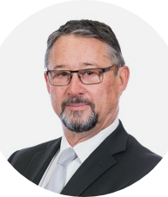
Corporate Snapshot
Board of Directors
Capital Structure*
Mr Malcolm Day
~1,567m
503m
Managing Director
Shares on issue
Unlisted Options
(84m @ 3.0c; 20m @ 1.6c; 399m @ 0.8c)
A civil engineer and licenced surveyor with 25 years as Managing Director of Moab Minerals Ltd (previously Delecta Ltd). Mr Day is also Non-Executive Director of European Lithium (ASX:EUR).
$4.7m
~$2.2m
Market Cap (@ 0.3c/share)
EV (incl. Director Loan of $500k)
Mr Bryan Hughes
$2.3m
11m
Non-Executive Chairman
Cash (28 Oct 2024)
incl. $2m capital raise
EUR shares ~$700k @ 6.2c (6 Dec 2024)
Excludes 11.02% interest in CAA Mining Ltd (Ghana)
Mr Hughes is the past Chairman and founding partner of Pitcher Partners, accountants, auditors and advisors and now a Director of 101 Advisory Pty Ltd. Mr Hughes has over 30 years of experience in the resources sector. He has developed and overseen commercial, operational and financial strategies which have led to the development and success of numerous companies in many jurisdictions around the world. Mr Hughes sits on several private and public company boards.
Current Top 6 hold 30% of MOM**
Malcolm Day
10.48%
Jetmax Trading
4.91%
Merrill Lynch (Australia) Noms
4.12%
Mr David Wheeler
Sunset Capital Management
3.33%
Non-Executive Director
Nero Resource Fund
3.19%
Over 30 years of senior executive management, directorships,
and corporate advisory experience. Mr Wheeler is a foundation Director and Partner of Pathways Corporate, a boutique corporate advisory firm.
Katherine Jensen and William Witham <Acorn Family A/C>
2.90%
* figures include $2 million capital raise @ 0.3c/share and 1-for-3 attaching options (@0.8c/sharte)
** figures as of 6 Dec 2024
4

Slide 5

Ownership Structure
MOAB Minerals Ltd
(ASX: MOM)
Relevant Entities
94%
100%
Linx Resources Pty Ltd (Australia)
Oryx Resources Ltd (United Kingdom)
Linx Resources Pty Ltd (Australia)
80%
Katika Resources Ltd (Tanzania)
Oryx Resources Ltd (United Kingdom)
Katika Resources Ltd (Tanzania)
Manyoni Project
Octavo Project
(Tanzania)
(Tanzania)
  Manyoni Project (Tanzania) – 100%
  Octavo Project (Tanzania) – 100%
PL 12224/2023 + PL 12225/2023
+ PL 12188/2023 + PL 12190/2023
+ PL 12191/2023 + PL 12323/2023
PL 11645/2021
5

Slide 6
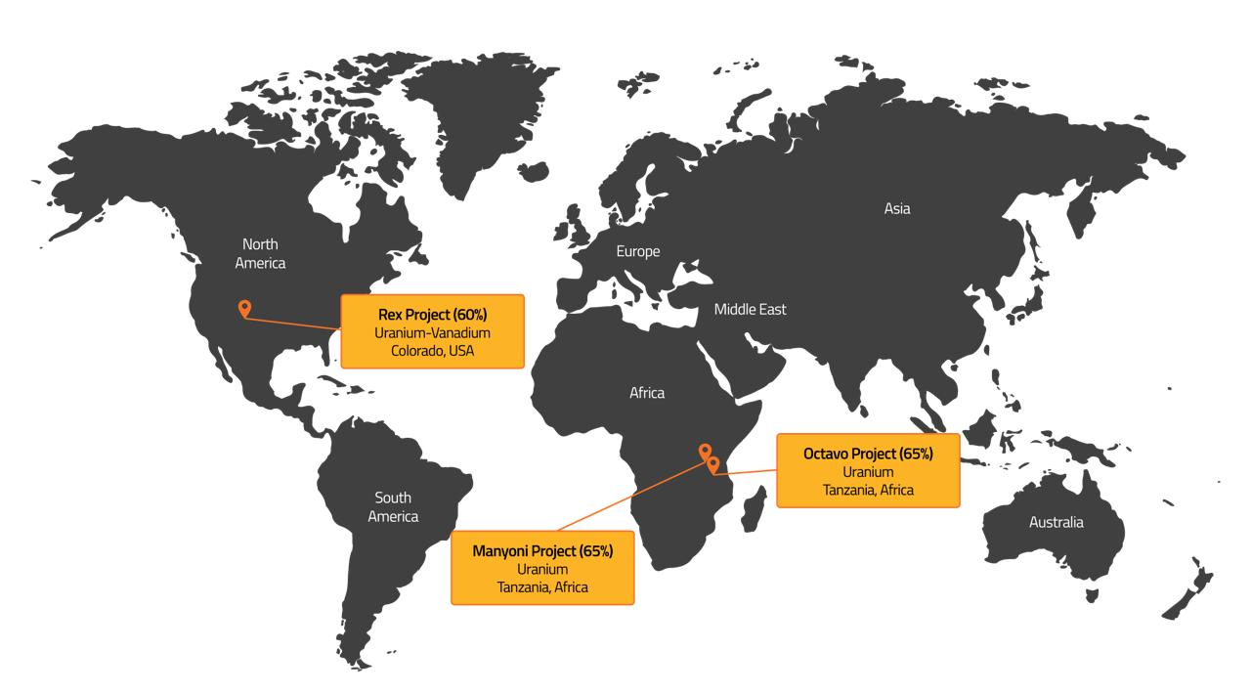
Uranium Project Portfolio
REX Project
Uranium
Colorado, USA
REX
Octavo Project
Uranium
Tanzania, Africa
Manyoni Project
Uranium
Tanzania, Africa
6

Slide 7
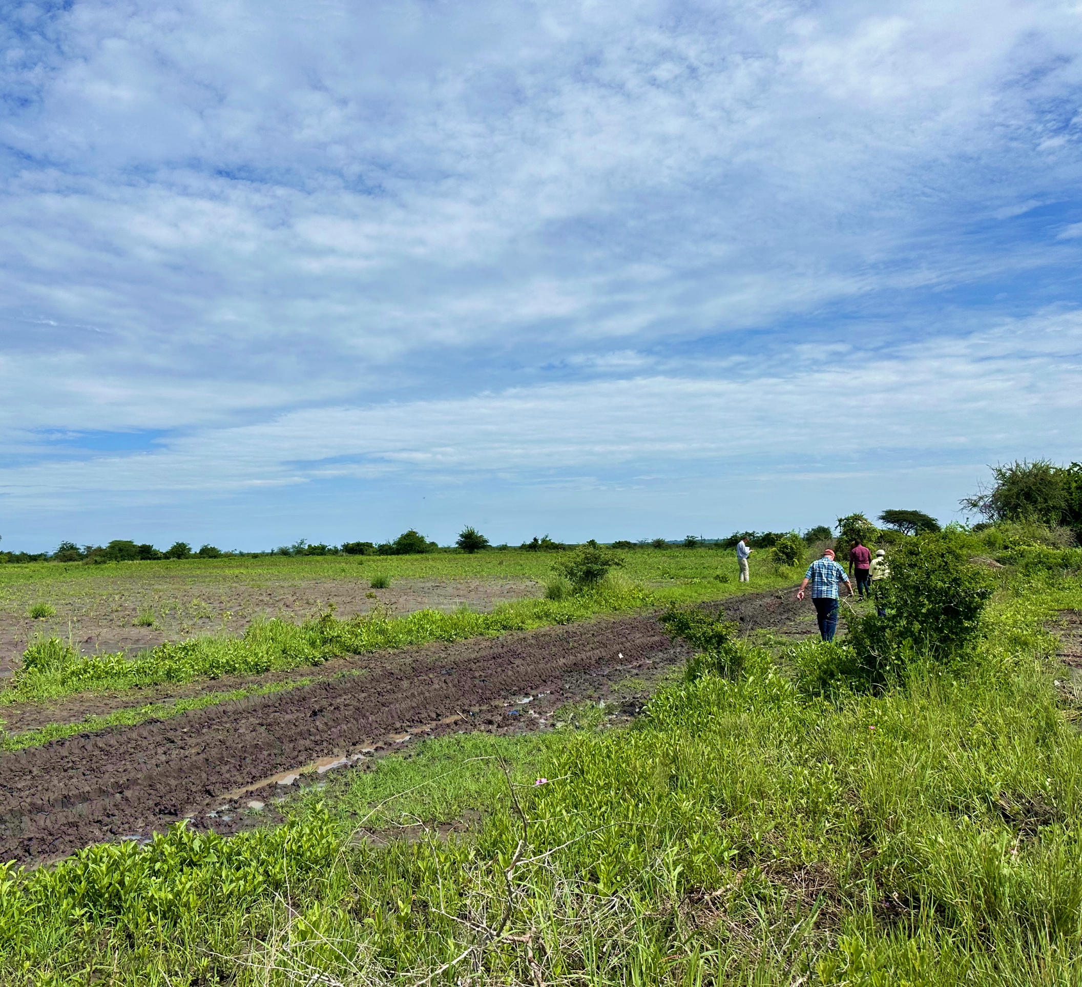
Manyoni & Octavo Projects
Uranium
Tanzania
7

Slide 8
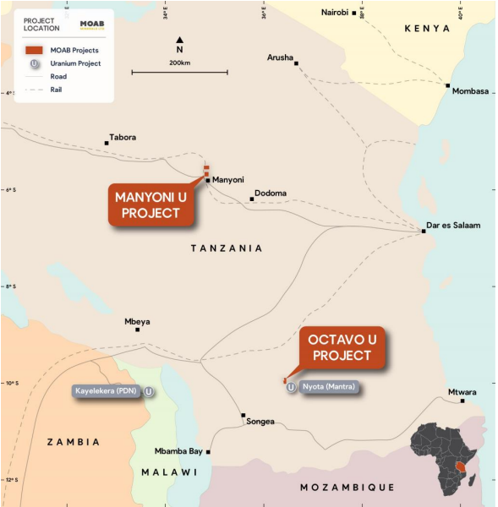

Acquisition of Linx Resources Pty Ltd
A Strategic Acquisition
Moab Minerals has acquired 94% of Linx Resources Pty Ltd,
holding a portfolio of advanced, large scale uranium projects in Tanzania.
Manyoni Project
(PL 12224/2023 and 12225/2023)
5km north of Manyoni town, access to rail, sealed roads, power and water resources
New AuKing Tenements
(PL 12188/2023, 12190/2023, 12191/2023 and 12323/2023)
Highly strategic and immediately adjacent to Manyoni Project (consolidating all historical Manyoni deposits)
Octavo Project
(PL 11645/2021)
Adjacent to Rosatom’s world class Nyota Uranium Deposit (formerly ASX-listed Mantra Resources; A$1.02B takeover in 2011)
Figure 1 – Location of Manyoni and Octavo Uranium Projects
8

Slide 9
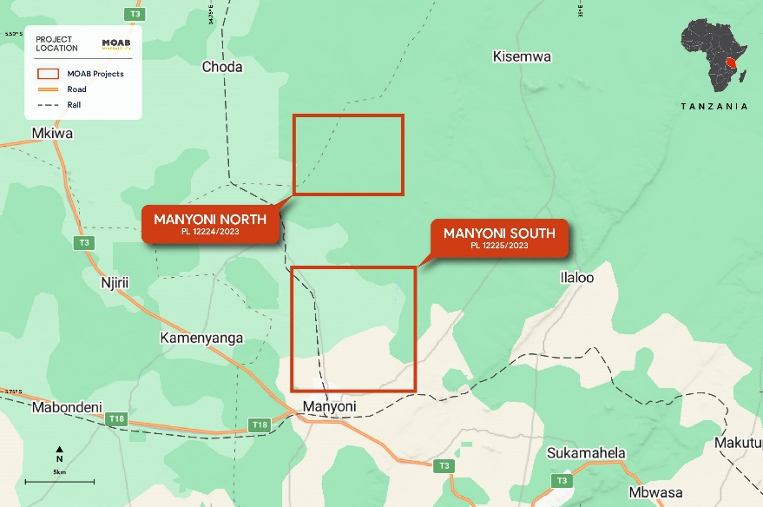
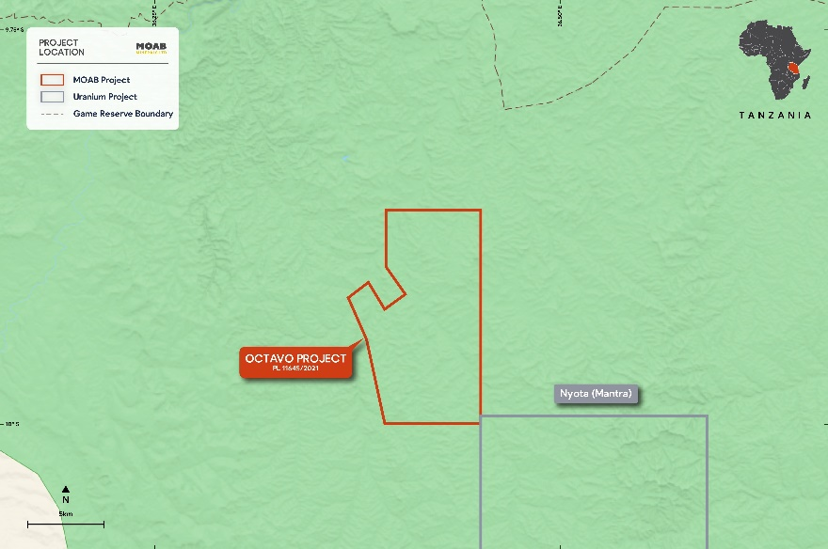
Manyoni and Octavo
Uranium Projects
High Impact Uranium Projects
Figure 2 – Location of Manyoni Tenements
The Manyoni Uranium Project tenements are located in the Republic of Tanzania (pop. 65 million), approximately 100km northwest of the capital city of Dodoma (pop. 765,000). The location of the uranium projects at Manyoni and Octavo are shown in Figure 2 and Figure 3.
The Manyoni Uranium Project was extensively explored by former owner,
ASX-listed company Uranex Ltd (ASX:UNX) now Magnis Energy Technologies
Ltd (ASX:MNS).
Historical multi-million dollar exploration program completed from early 2000’s – 2013 by Uranex Ltd¹.
Figure 3 – Location of Octavo Tenement
ASX Release, “Acquisition of Portfolio of Advanced Uranium Assets Tanzania”, 12 March 2024
9

Slide 10
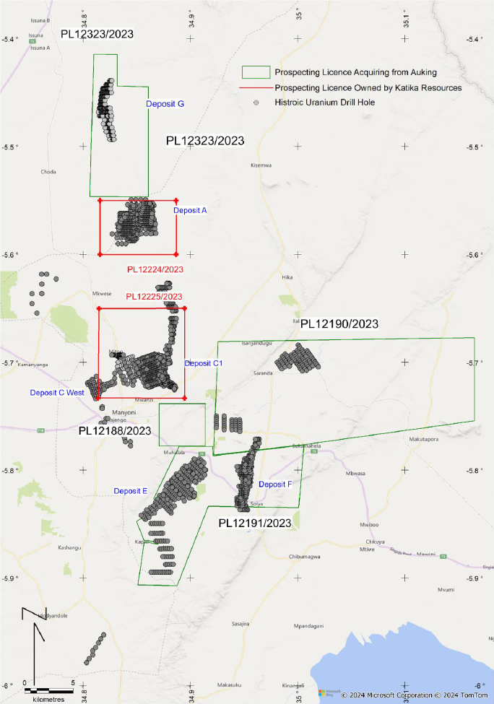
New AuKing
Tenements
Highly Strategic Consolidation of Historical Manyoni Project Deposits
Binding agreement with AuKing (ASX:AKN) to acquire four highly prospective prospecting licenses adjacent to Manyoni
New tenements are highly strategic covering parts of the historic Manyoni Uranium Project held by Uranex (ASX:UNX) prior to 2013
Acquisition of these additional surrounding tenements adds significant upside potential to Manyoni
Figure 4 – Manyoni Prospecting Licences
10

Slide 11

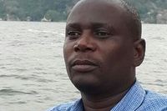
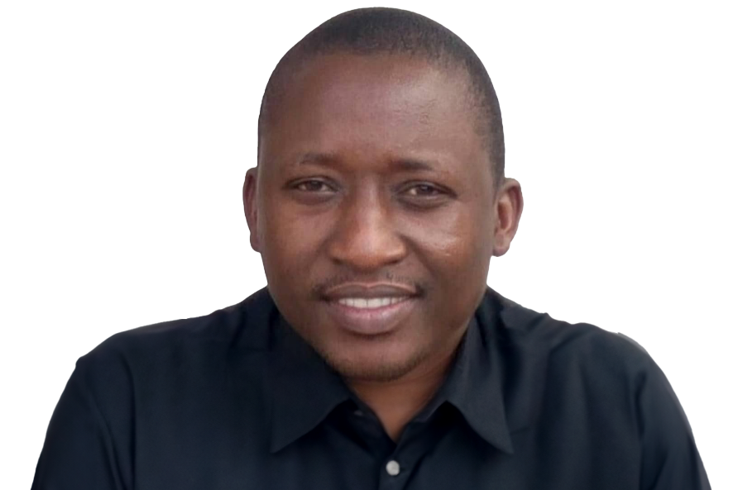
In-Country Management
Mr Godluck Sekwao
Exploration Manager
Experienced geologist with 16 years across all aspects of geological projects and a particular focus on exploration. Most recently working with Shanta Gold across its East African projects.
Mr Charles Sayi Mihayo
Senior Geologist
Charles is an experienced geologist with over 18 year across Africa in project discovery, development, and mining production across a range of commodities.
Mr Ryoba Chacha
Consulting Geologist
Ryoba has over 15 years of experience working on geological projects, particularly in East Africa.
He has also previously worked on the Manyoni Project as a Project Geologist with Uranex Ltd.
11

Slide 12






Why Tanzania?
Tanzania makes its way to the stage within the international mining sector
Government commitment, support, and incentives for foreign investment
First Tanzanian participation at Mining Indaba in February 2024
Uranium deposits largely underexplored compared to established neighbours (e.g., Namibia and Niger)
Specific government focus on developing uranium sector
Protection from nationalisation, tax incentives and repatriation of capital
Emerging mining jurisdiction with stable macroeconomic and political climate
English common law system and favourable industry conditions
One of the fastest growing African economies, supported by political stability
Potential high-impact prospects (Manyoni Project
& Octavo Project - adjacent to Rosatom’s world class Nyota Uranium Deposit)
English language spoken for foreign trade, diplomacy, education and legal proceedings
Skilled geological workforce and existing infrastructure thanks to a well established mining industry
An Increasingly Decarbonised World
Government aims to have Mining at 10% of GDP by 2025¹
Continued geopolitical uncertainty and demand for decarbonised power alternatives
Through a portfolio of advanced, large scale uranium projects in Tanzania, Moab can contribute to such a demand
Government is seeking to fast track the drilling process for mining and energy projects
Tax exemptions and other incentives in place under the 2022 Finance Bill
https://www.tic.go.tz/sectors/mining-sector
12

Slide 13

Exploration Program
Manyoni + Octavo Projects in 2024/2025
Drilling
Program
Commences
Scoping
or PFS
Assay Results
Sep-24
Qtr
Dec-24
Qtr
Mar-25
Qtr
Jun-25
Qtr
Sep-25
Qtr
Dec-25
Qtr
Validation/
Extension
Drilling
13

Slide 14
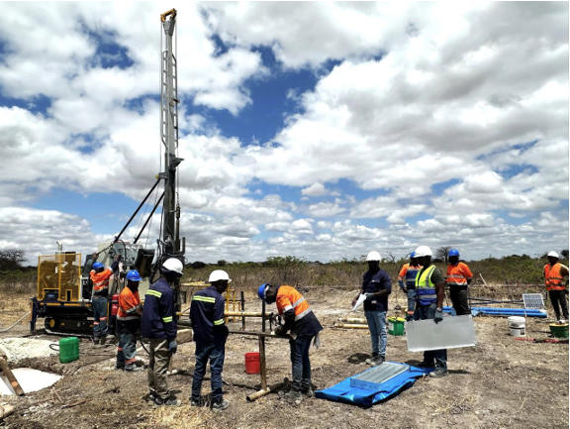
Drilling Program
Manyoni Project
Stage 1 extensive core drilling program (105 holes)
commenced in August 2024¹
Two stage drilling program, including validation drilling (Stage 1) and exploration drilling (Stage 2)
Stage 1 drilling is designed to verify historical drill results
while Stage 2 drilling (100 core holes) is designed to locate extensions to the known mineralisation
Exploration and management team in Tanzania established and in place (including Dar Es Salaam) to support ongoing drilling and evaluation work
Figure 5 – Core drilling underway in August 2024
ASX Release, “Drilling underway at the Manyoni Uranium Project in Tanzania”, 3 September 2024
14

Slide 15
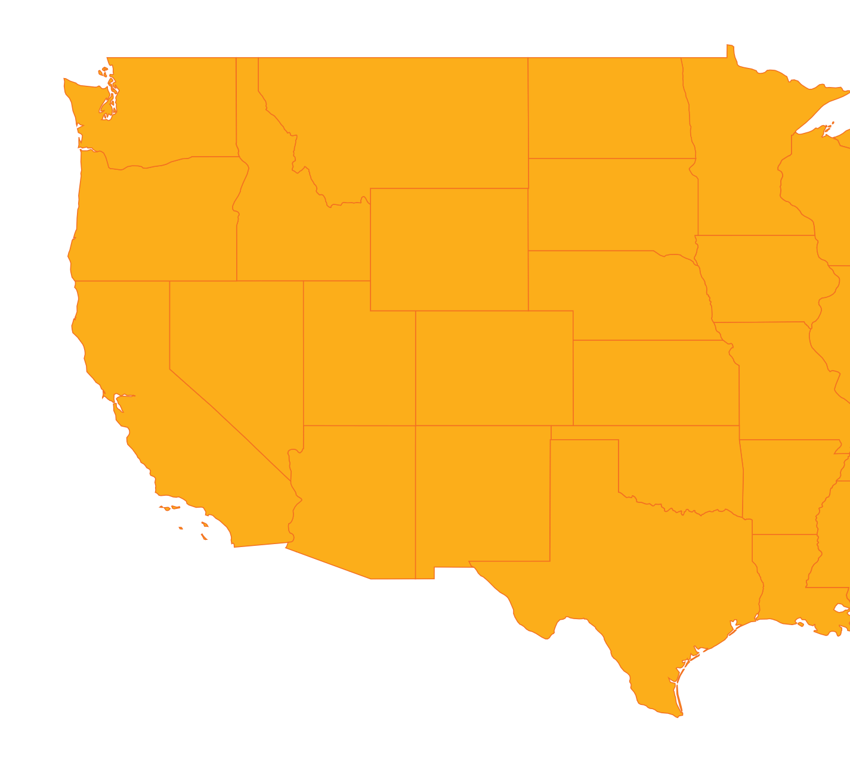

USA Uranium Asset
Part of a
High Potential Asset Portfolio
REX Uranium Project
REX PROJECT
Colorado
Part of the famed Uravan Minerals Belt
60% Ownership by Moab (via Sunrise Minerals Ltd)
Seeking JV partner given focus is Manyoni Project
15

Slide 16





Uranium in the USA
The future of power in the US is nuclear - domestic supply must be secured
18.9% of Power
US$6b
US$2.5b
48% Clean Energy
Less Than 9%
in the US comes
from nuclear¹
Program by President
Biden to help save nuclear power plants²
Committed to two
projects to demonstrate new nuclear technology³
in the US is generated
from nuclear power⁴
of uranium used in
US nuclear reactors is produced domestically⁵
https://www.eia.gov/tools/faqs/faq.php?id=427&t=3
https://www.reuters.com/business/energy/blow-biden-climate-plan-entergy-shuts-nuclear-power-plant-2022-05-20/#:~:text=The%20Biden%20administration%20last%20month,natural%20gas%20and%20renewable%20energy
https://www.nytimes.com/2022/07/05/business/energy-environment/nuclear-energy-politics.html#:~:text=In%20addition%20to%20the%20%246,energy%20in%20the%20United%20States
https://www.energy.gov/ne/articles/5-fast-facts-about-nuclear-energy
https://css.umich.edu/publications/factsheets/energy/nuclear-energyactsheet#:~:text=U.S.%20nuclear%20plants%20purchased%2022%2C135,%25)%20and%20Australia%20(11%25).&text=Globally%2C%20nuclear%20power%20reactors%20are,mt%20of%20uranium%20in%202021
16

Slide 17
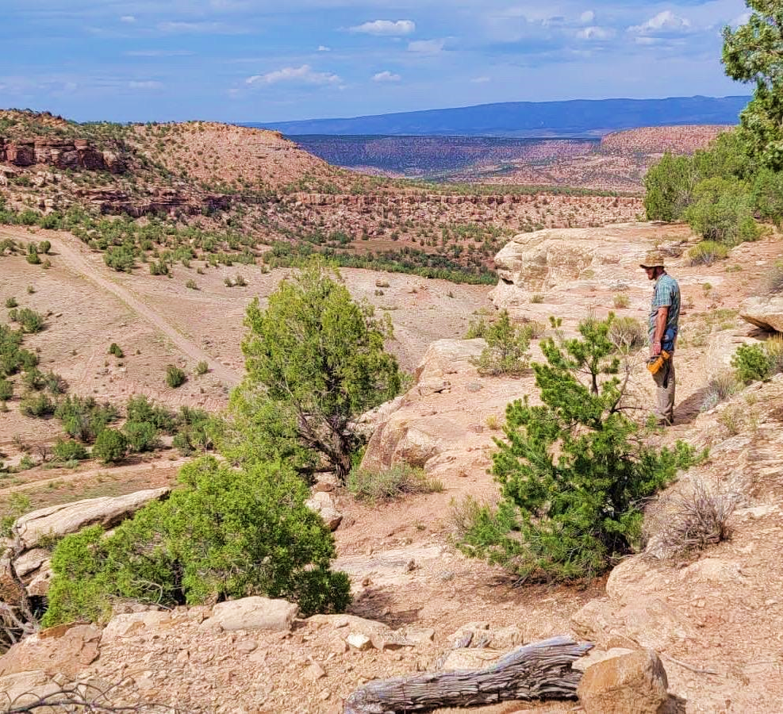
REX Project
Uranium
Colorado
17

Slide 18
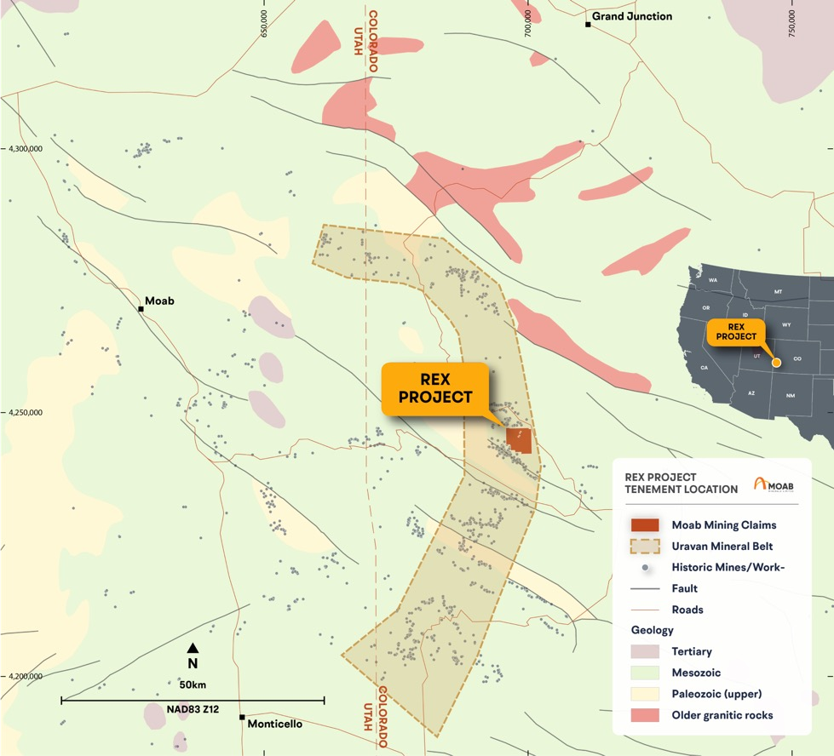
REX Uranium-Vanadium Project
Overview
60% owned by Moab and contains many historic uranium mines including Blackfoot/Rattlesnake, Wedge, Merry Widow, Sunbeam and Vanadium King that have not been subject to exploration since the 1970’s other than sampling by Moab
256 contiguous BLM mining claims (~5,000 acres which is 20km²)
Located ~130 km east of the town of Moab
The region is famous for the nearby Mi Vida uranium mine discovered in 1952 by Charlie Steen – The Mt Vida district produced 22,000 tonnes of U₃0₈ to 1965¹
Within trucking distance of the White Mesa Mill, the only operating conventional uranium mill in the US that has 90% spare capacity available to toll treat mined ore
Figure 6 – Location Rex Uranium-Vanadium Project
1 – Hiram B Wood (1969) Geology and Exploitation of Uranium Deposits in the Lisbon Valley Area, Utah in Ore Deposits of United States 1933 – 1967, Vol-1.
18

Slide 19
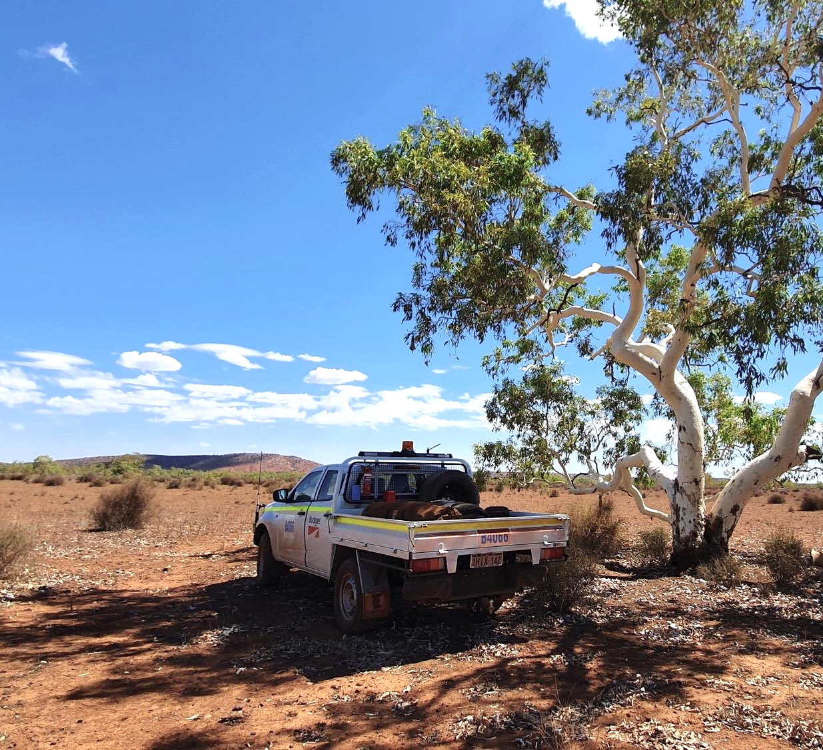
ASX:MOM
Contact
Malcolm Day
mal@moabminerals.com.au
moabminerals.com.au
Jane Morgan
jm@janemorganmanagement.com.au
INVESTOR PRESENTATION
DECEMBER 2024

